Slide 1
Topic: Software packages for quantum computing

Slide 2
What we will cover?
Stage | Lesson | Topics
Stage 1: Understand QML - concepts, applications, two models | 1 What is QML? (today) | Taxonomy · Research goals · Tools
 | 2 Quantum kernel methods | QKM / SVM + RBF kernel
 | 3 Quantum neural networks | QNN / Neural networks · Wrap-up
Stage 2: Idea to software - research question → paper → package | 4 From idea to paper | Research question - First paper
 | 5 From paper to package | Qmes

Slide 3
What is QML, and what tools do we use?
Lesson 1 · Quantum machine learning

Slide 4
Outline
What is QML
Taxonomy
Research goals
Tools

Slide 5
1. Machine learning today
What ML does: learn patterns from data
  Instead of hand-written rules
  Images, speech, spam, finance
What powers it: CPU → GPU
  The engine of AI and big data
  Data and compute keep growing
Where it is heading: bigger models
  Rising training cost
  Moore's law slowing down?
Meanwhile, in physics: quantum computers, born for a different reason

Slide 6
1. Quantum computers
Built to simulate physics, not to do machine learning
Early 1980s · Feynman's idea
  Simulate quantum systems with quantum systems
  𝑁 qubits need 2^{𝑁} numbers on a classical computer
1990s · Beyond simulation
  Shor: factoring in polynomial time
  Grover: quadratic speedup for unstructured search
2019 → · Hardware today
  Quantum supremacy on one chosen task
  Tens to hundreds of qubits, still noisy
Note: the most famous result, factoring, has nothing to do with AI at first sight

Slide 7
1. Quantum machine learning
Machine learning + quantum computing → Quantum machine learning (QML)
  Common ground: linear algebra (vectors, matrices, Hilbert space)
Era 1 · fault-tolerant algorithms
  HHL, quantum PCA, quantum SVM
  Needs error-corrected hardware
Era 2 · from ~2018: models for noisy devices
  Quantum kernels, quantum neural networks
  Lessons 2–3
QML: running a learning algorithm on a quantum computer for a specific task, hoping for an advantage over classical

Slide 8
2. QML taxonomy?
 | Classical algorithm | Quantum algorithm
Classical data | Classical ML Images, speech, spam, finance In daily use | Quantum models on classical data (this course) Classification, clustering, recommendation, finance Small trials, no known advantage
Quantum data | ML for quantum experiments Phases of matter, state reconstruction, ground states Applied in physics | Quantum processing of quantum data Learning directly from quantum experiments Proof of principle, up to 40 qubits

Slide 9
3. Two research goals
A · Quantum advantage
B · Quantum learning
Can quantum do what classical cannot?
Now, briefly
How do QML models work?
Lessons 2–3, in detail

Slide 10
3. Goal A: quantum advantage
Claim | Promise | Conditions
Runtime speedup | Linear systems, PCA, SVM in ~log N instead of N | Sparse, well-conditioned data; error correction; data loading; only one number out
Classical hardness | Quantum kernels that classical computers cannot compute | Proven only on purpose-built problems; error correction; not yet for images or text
Quantum data | Exponentially fewer experiments | Quantum memory; proof of principle so far
Counter-argument: dequantization | Classical algorithm, same data access, nearly as good | The exponential gap disappears
→ It always depends on the data, the input model, and the classical baseline.

Slide 11
3. Why goal A is hard for ML
 | Problems studied in quantum computing | Problems solved by machine learning
Classical performance | Weak: problems chosen to be hard | Strong: industrial scale
Input size | Small: few qubits, short bit strings | Very large
Structure | Highly structured | Messy, real-world
Evaluation | Asymptotic complexity | Empirical benchmarks
→ Goal B: understand how QML models work, without having to beat classical

Slide 12
4. Three libraries, three purposes
 | PennyLane | Qiskit | Cirq
Built for | Differentiable programming: a circuit as a layer in an ML model | Build circuits, optimize them for a device, run on hardware | Fine-grained control of circuits on today's noisy devices
Gradients & ML | Built in, connects to PyTorch / JAX | Separate library, not in the core | Not the focus
Runs on | Many simulators and hardware via plugins | Hardware via vendor runtimes and providers | Built-in simulators, noise models, Google chips

Slide 13
4. Summary: from taxonomy to tools
1 Taxonomy: where does QML live? | 2 Objective: what do researchers want? | 3 Platform: how do we build it?
Classical / quantum data × classical / quantum algorithm This course: quantum models on classical data Context only: classical ML, ML for quantum experiments, quantum processing of quantum data | A · Quantum advantage: can quantum beat classical? Runtime speedup · classical hardness · quantum data Counter-argument: dequantization B · Quantum learning: how do QML models work? QKM (Lesson 2) · QNN (Lesson 3) | Qiskit: build circuits, compile, run on hardware Cirq: fine-grained control of noisy devices PennyLane: used in this course Built-in gradients · circuits as Python functions · PyTorch / JAX interfaces

Slide 14
Quantum kernel methods
What does the quantum computer do inside an SVM?
Lesson 2 · Quantum machine learning

Slide 15
Outline
SVM & kernels
Quantum kernel
Cost & failure

Slide 16
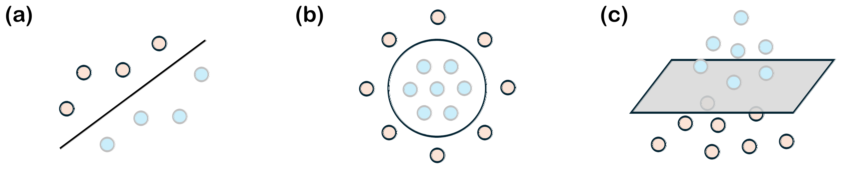
1. Kernel methods: the original idea
Separable by a line
Not separable by a line
Higher dimension: separable by a plane
Map the data to a higher dimension, then separate it with a hyperplane

Slide 17
1. Feature map and kernel
Feature map
  𝑥 ∈ ℝ^{𝑑} → 𝜑(𝑥) ∈ ℝ^{𝐷}, 𝐷 ≥ 𝑑
  𝜑(𝑥): feature vector
Kernel
  𝑘(𝑥, 𝑥′) = ⟨𝜑(𝑥), 𝜑(𝑥′)⟩
  Similarity of two points
  Computed without writing 𝜑(𝑥): kernel trick
RBF kernel: 𝜑 hidden, 𝑘 by formula
  𝑘(𝑥, 𝑥′) = 𝑒^{−𝛾‖𝑥 − 𝑥′‖²}
  𝜑(𝑥) infinite-dimensional, never written down

Slide 18
1. Support vector machine
Max-margin hyperplane: separates the two classes, as far as possible from both
Support vectors: the points closest to the hyperplane
Non-linear data: use a kernel, separate in feature space
SVM only needs the numbers 𝑘

Slide 19
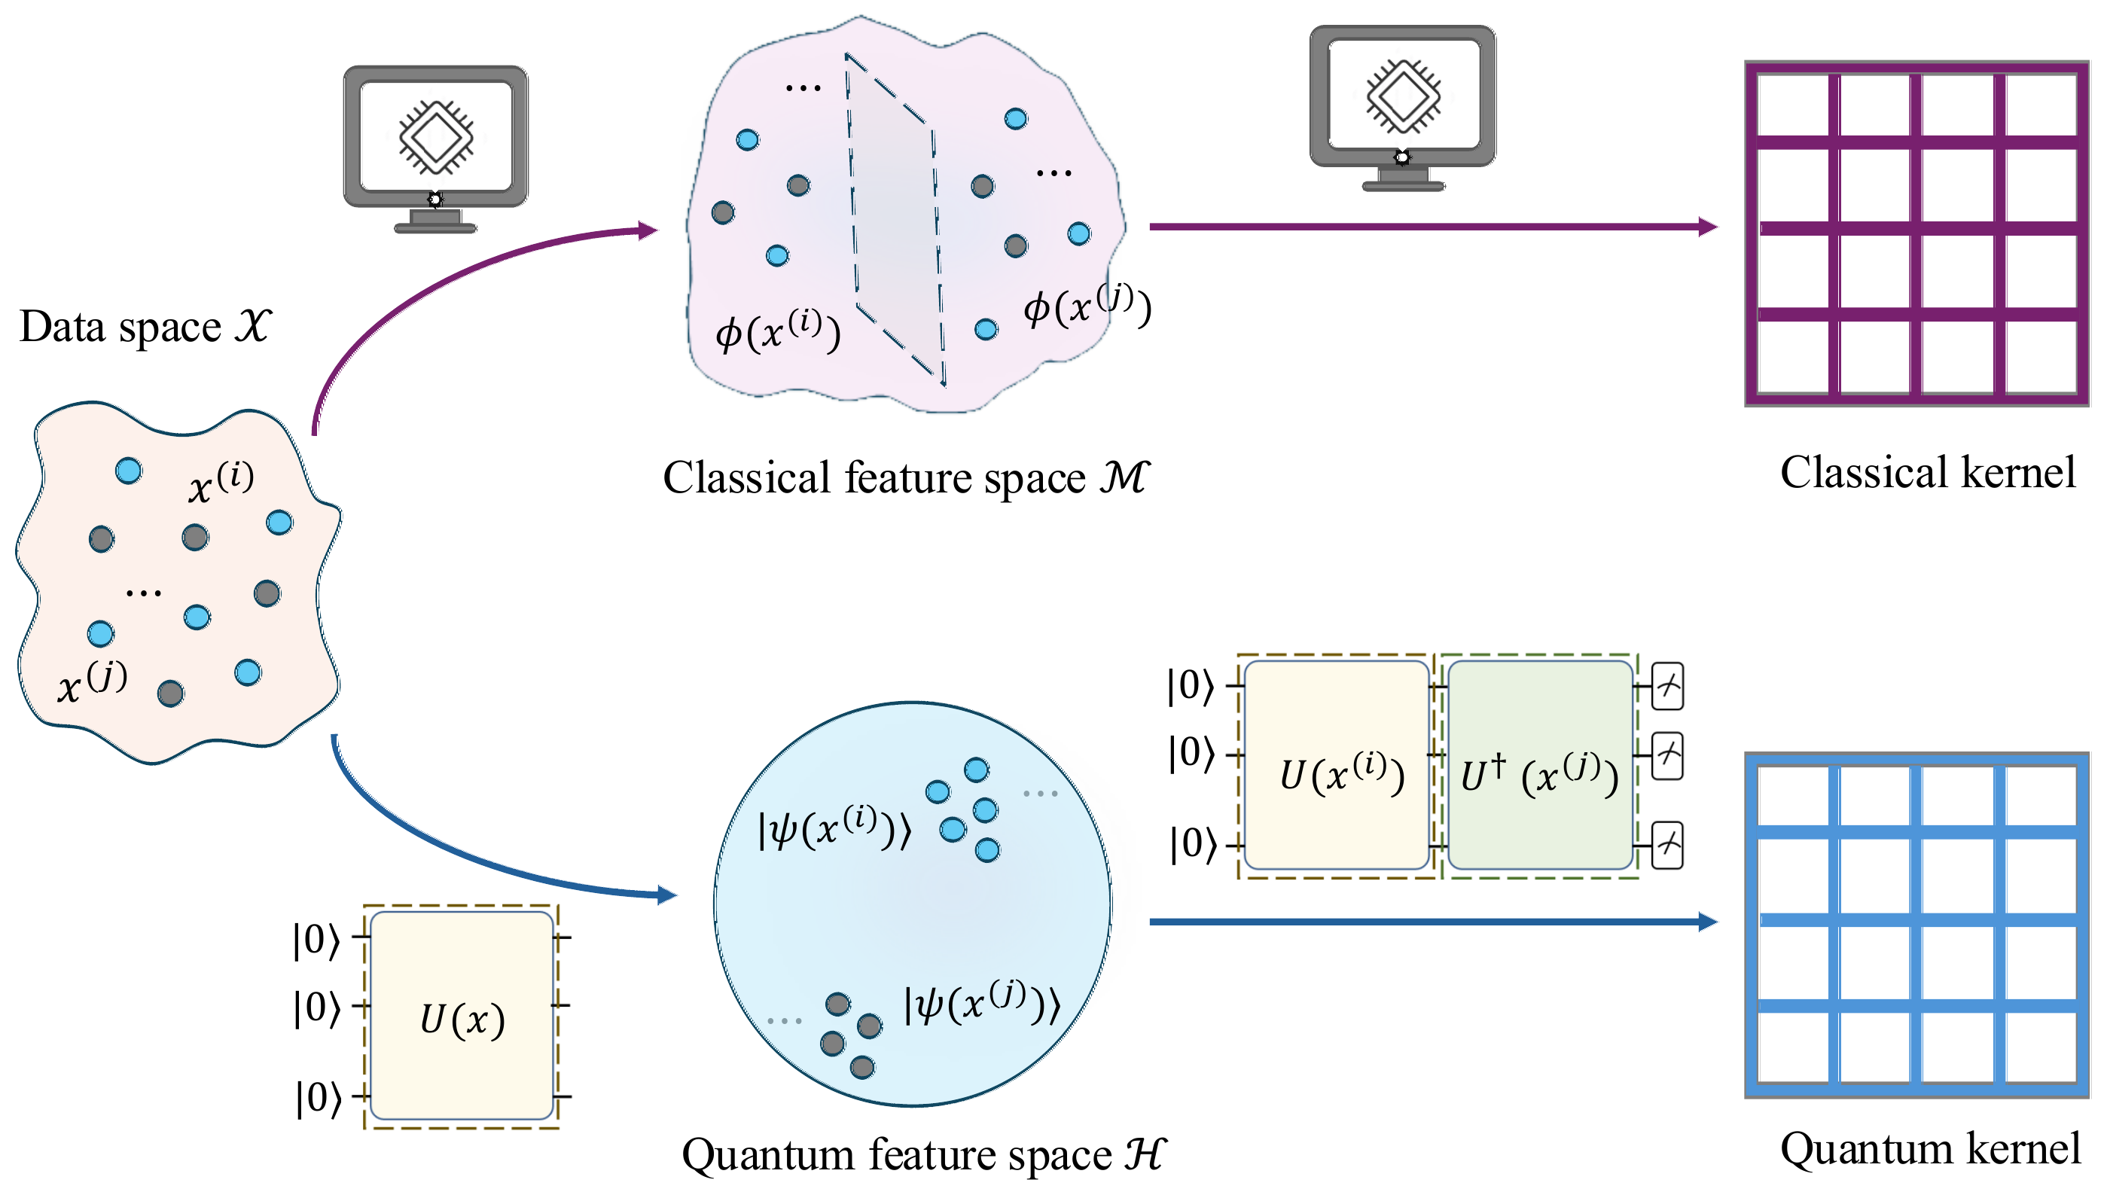
2. Quantum kernel
Feature map
  |𝜓(𝑥)⟩ = 𝑈(𝑥)|0⟩^{⊗𝑛}
  𝑈(𝑥): data-dependent circuit on 𝑛 qubits
Kernel
  𝑘(𝑥, 𝑥′) = |⟨𝜓(𝑥)|𝜓(𝑥′)⟩|²
  1: same state · 0: very different
Only the feature map changes: 𝜑(𝑥) → |𝜓(𝑥)⟩

Slide 20
2. How to calculate K (Gram matrix)
Quantum hardware
One circuit per pair, repeated many times
Circuit: |00⟩ → 𝑈(𝑥₁) → 𝑈†(𝑥₂) → measure
Simulator (lab)
Simulate each point once, keep the state in memory
|𝜓(𝑥₁)⟩ = (0.816, −0.558𝑖, −0.084, −0.123𝑖)
|𝜓(𝑥₂)⟩ = (0.358, −0.801𝑖, −0.438, −0.196𝑖)
2^{𝑛} = 4 numbers per point
𝐾₁₂ = |⟨𝜓(𝑥₁)|𝜓(𝑥₂)⟩|² = 0.641
𝐾₁₂ ≈ 652/1000
= 0.652
2 qubits, toy encoding RX + CNOT, 𝑥₁ = (0.3, 1.2), 𝑥₂ = (1.0, 2.3)
Same 𝐾: 0.652 from 1000 shots, 0.641 exact

Slide 21
2. QKM = two blocks
Train data: pairs (𝑥_{𝑖}, 𝑥_{𝑗}) → quantum block
Quantum: compute 𝐾 (fixed circuit, nothing trained · hardware or simulator)
  Feature map: |𝜓(𝑥)⟩ = 𝑈(𝑥)|0⟩^{⊗𝑛}
  Kernel evaluation: 𝐾_{𝑖𝑗} = |⟨𝜓(𝑥_{𝑖})|𝜓(𝑥_{𝑗})⟩|²
  Post-processing: all pairs → matrix 𝐾
Classical: SVM
  Train: 𝐾 → 𝛼, 𝑏 (trained here)
  Predict: sign(Σ_{𝑖} 𝛼_{𝑖} 𝑦_{𝑖} 𝑘(𝑥_{𝑖}, 𝑥) + 𝑏)
Prediction: new 𝑥 → quantum block gives 𝑘(𝑥_{𝑖}, 𝑥) → Predict

Slide 22
2. Training = SVM dual
Train
  max_{𝛼} Σ_{𝑖} 𝛼_{𝑖} − ½ Σ_{𝑖,𝑗} 𝛼_{𝑖} 𝛼_{𝑗} 𝑦_{𝑖} 𝑦_{𝑗} 𝐾_{𝑖𝑗}
  0 ≤ 𝛼_{𝑖} ≤ 𝐶, Σ_{𝑖} 𝛼_{𝑖} 𝑦_{𝑖} = 0
Predict
  ŷ(𝑥) = sign( Σ_{𝑖} 𝛼_{𝑖} 𝑦_{𝑖} 𝑘(𝑥_{𝑖}, 𝑥) + 𝑏 )
𝐾_{𝑖𝑗} from
  Classical (RBF): formula exp(−𝛾‖𝑥_{𝑖} − 𝑥_{𝑗}‖²)
  Quantum: circuit |⟨𝜓(𝑥_{𝑖})|𝜓(𝑥_{𝑗})⟩|²
Data enters only through 𝐾

Slide 23
2. What this means
Quantum: only 𝐾
  Optimization runs on a classical computer
  SVC(kernel="precomputed")
Convex
  Global optimum
  No circuit gradients
Quality of 𝐾
  Model quality ≈ quality of 𝐾 ≈ choice of encoding

Slide 24
3. SVM + RBF vs QKMs
 | SVM + RBF | QKM
Already seen
Feature map | Hidden, infinite-dim | Circuit 𝑈(𝑥) → |𝜓(𝑥)⟩, 2^{𝑛} amplitudes
Kernel | Formula 𝑒^{−𝛾‖𝑥−𝑥′‖²} | Run circuit
Optimization, prediction | SVM dual, convex | Identical
What follows
Hyperparameters | 𝐶, 𝛾 | 𝐶, encoding, data scale
Cost of 𝐾 | 𝑁(𝑁−1)/2 formula evaluations | 𝑁(𝑁−1)/2 circuits × shots
Failure | 𝛾 too large → 𝐾 ≈ 𝐼 | 𝐾 ≈ 𝐼 (next)

Slide 25
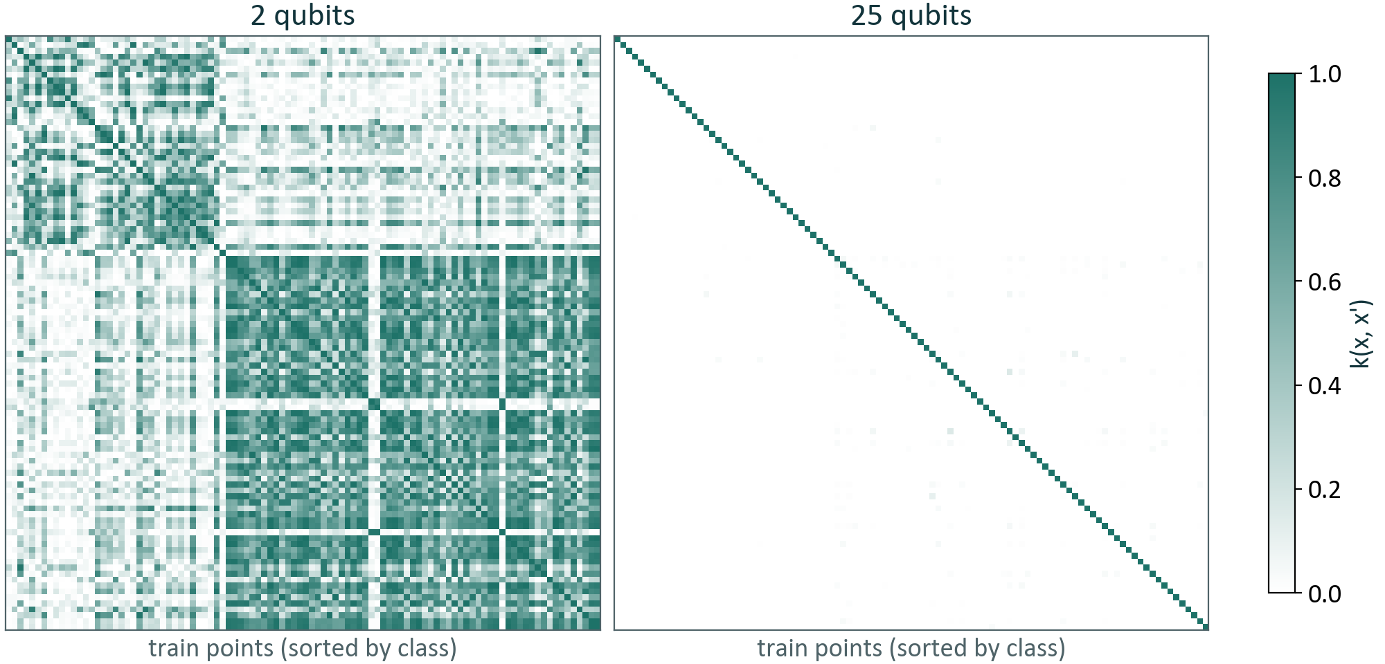
3. Exponential concentration: 𝐾 ≈ 𝐼
More qubits → 𝑘(𝑥, 𝑥′) → 0 for 𝑥 ≠ 𝑥′: 𝐾 ≈ 𝐼
Product encoding: 𝑘 = product of 𝑛 numbers < 1
Hardware: 0…0 almost never seen: measured 𝐾 = 𝐼 → same prediction for every input
Breast cancer, 100 train points, product-RX encoding, exact 𝐾

Slide 26
3. Three sources of concentration
Expressivity: encoding covers too much of state space → states nearly orthogonal
Global measurement: all 𝑛 qubits measured at once; even without entanglement
Noise: hardware noise, worse with deeper circuits
Fix: keep 𝑘 from getting tiny
  Simpler encoding
  Smaller data scale
  Encoding built on data structure

Slide 27
Quantum neural networks
Lesson 3 · Quantum machine learning

Slide 28
Outline
Definition
Training
NN vs QNN
Barren plateau
Wrap-up

Slide 29
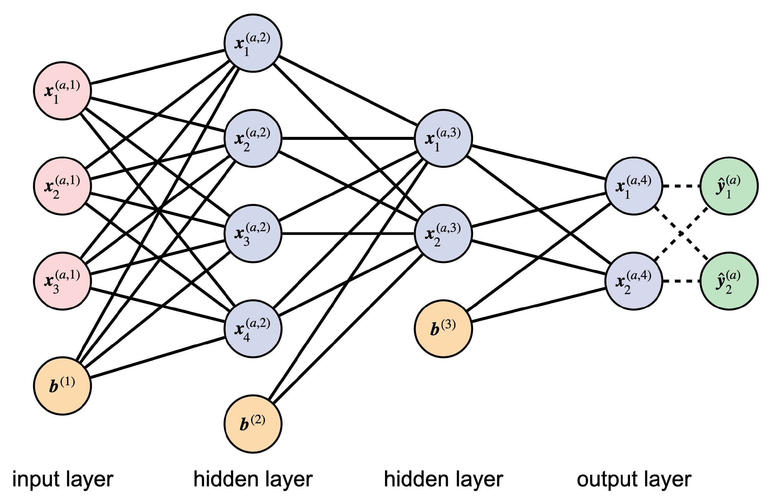
1. Neural network
Three parts
  Input layer → hidden layers → output layer
Each layer
  𝑧 = 𝑊𝑥 + 𝑏, then 𝜎(𝑧)
  Non-linear activation
Trained
  𝑊, 𝑏

Slide 30
1. Quantum neural network (QNN)
Circuit: |0⟩^{⊗𝑛} → encoding 𝑈(𝑥) → ansatz 𝑉(𝜃) → measure 𝑂
Encoding: |𝜓(𝑥)⟩ = 𝑈(𝑥)|0⟩^{⊗𝑛} · same as QKM
Ansatz 𝑉(𝜃): trainable circuit · new
Measure observable 𝑂: e.g. 𝑍 on qubit 1
𝑓_{𝜃}(𝑥) = ⟨𝜓(𝑥)| 𝑉(𝜃)† 𝑂 𝑉(𝜃) |𝜓(𝑥)⟩ ∈ [−1, 1]
Prediction: sign(𝑓_{𝜃}(𝑥))

Slide 31
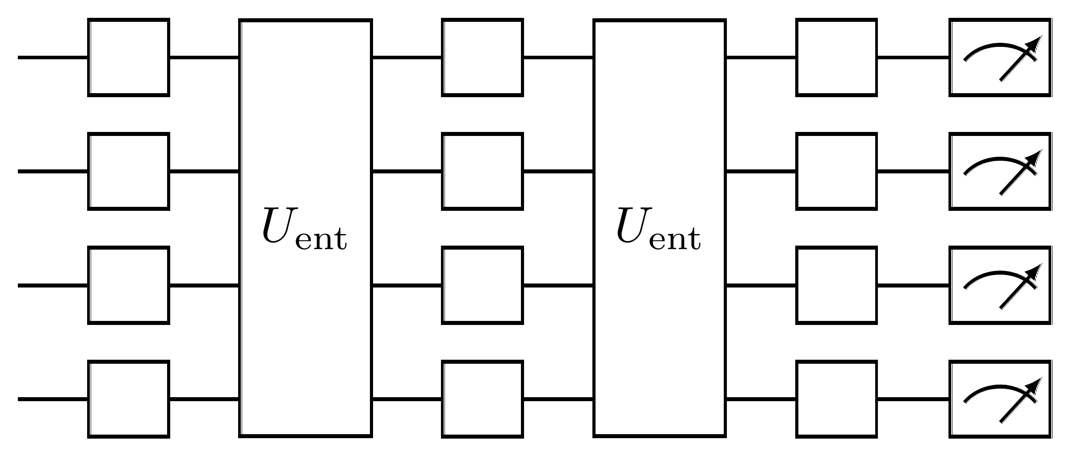
1. Variational block: ansatz 𝑉(𝜃)
Trainable: single-qubit rotations RX, RY, RZ
  Angles = 𝜃
Fixed: two-qubit gates CNOT / CZ
  Entanglement
Repeat 𝐿 layers
  𝐿 is a hyperparameter
QKM: fixed circuit · trained 𝛼 outside the quantum computer
QNN: trained 𝜃 inside the circuit

Slide 32
1. QNN = two blocks and a loop
Train data: (𝑥_{𝑖}, 𝑦_{𝑖}) → quantum block
Quantum: compute 𝑓 (hardware: average over shots · simulator: exact)
  Encoding: 𝑈(𝑥_{𝑖})
  Ansatz: 𝑉(𝜃), trainable
  Measure: 𝑂 → 𝑓_{𝜃}(𝑥_{𝑖})
Classical: train 𝜃
  Loss: compare 𝑓_{𝜃}(𝑥_{𝑖}) with 𝑦_{𝑖}
  Optimizer: 𝜃 → new 𝜃, back into the ansatz
Training loop: measure → loss → optimizer → ansatz
Prediction: new 𝑥 + trained 𝜃 → 𝑓_{𝜃}(𝑥) → sign(𝑓_{𝜃}(𝑥))

Slide 33
2. Training: same as NN
 | Neural network | QNN
Loss | 𝐿 = ½ Σ_{𝑖} (ŷ_{𝑖} − 𝑦_{𝑖})² | 𝐿(𝜃) = ½ Σ_{𝑖} (𝑓_{𝜃}(𝑥_{𝑖}) − 𝑦_{𝑖})²
Update | 𝑊 ← 𝑊 − 𝜂∇𝐿 | 𝜃 ← 𝜃 − 𝜂∇𝐿 (or Adam)
Gradient | Backprop | ∇𝐿 = Σ_{𝑖} (𝑓_{𝜃}(𝑥_{𝑖}) − 𝑦_{𝑖}) ∇𝑓_{𝜃}(𝑥_{𝑖})
Landscape | Usually non-convex | Usually non-convex (QKM: convex)
New: ∇𝑓_{𝜃}(𝑥), with 𝜃 inside the circuit

Slide 34
2. On hardware, ∇𝑓 costs 2 runs per parameter
Quantum hardware
Simulator (lab)
State cannot be read mid-circuit → no backprop
∂𝑓/∂𝜃_{𝑘} = ½ [ 𝑓(𝜃_{𝑘} + 𝜋/2) − 𝑓(𝜃_{𝑘} − 𝜋/2) ]
2 circuit runs per parameter, each averaged over shots
Per training step: 21,840 circuit runs, each × shots
  2𝑃𝑁 with 𝑃 = 24 parameters, 𝑁 = 455 training points
State in memory → backprop, as in NN
∂𝑓/∂𝜃₁ on the lab circuit:
  +0.0809 (parameter-shift)
  +0.0809 (backprop)
Same gradient

Slide 35
3. NN vs QNN
 | Neural network | QNN
Same recipe as NN
Model | Layers: affine + activation | Encoding → ansatz 𝑉(𝜃) → measure 𝑂
Optimization | Same loss, GD / Adam, usually non-convex | Identical
Gradient | Backprop, exact | Parameter-shift: 2 runs per parameter, shot noise
What changes
Features | Learned: hidden layers change with 𝑊 | Fixed by the encoding; 𝜃 cannot change them
Non-linearity in 𝑥 | At every layer | Only in the encoding; 𝐿 layers = one unitary
Failure | Vanishing gradient with depth | Barren plateau with qubit number (next)

Slide 36
3. QNN as a linear model
𝑓_{𝜃}(𝑥) = ⟨𝜓(𝑥)| 𝑉(𝜃)† 𝑂 𝑉(𝜃) |𝜓(𝑥)⟩ = ⟨𝜓(𝑥)| 𝑀(𝜃) |𝜓(𝑥)⟩
𝑥 enters only through |𝜓(𝑥)⟩ → fixed features
𝜃 enters only through 𝑀(𝜃) → trained weights
Closer to a linear model on fixed features (like logistic regression) than to an NN
Same features as the quantum kernel: a large class of QML models are kernel methods

Slide 37
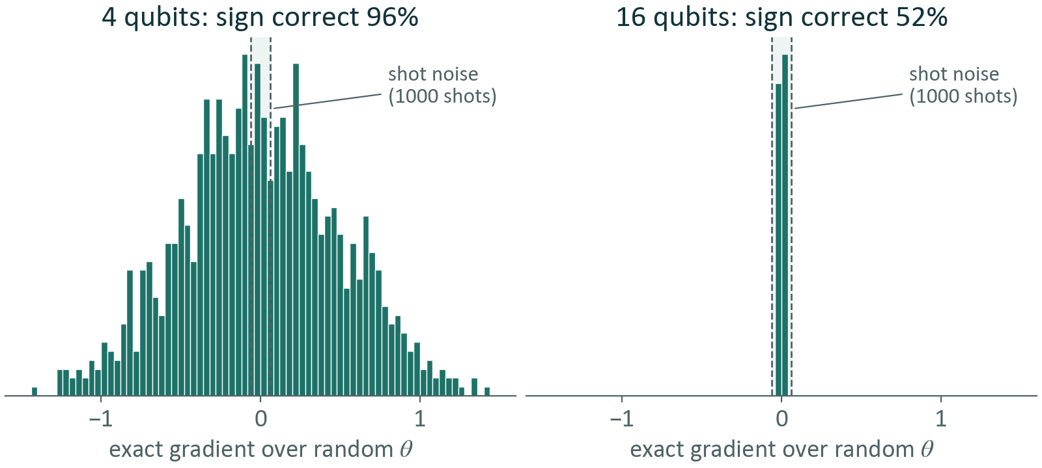
4. Barren plateau: gradient below shot noise
NN: vanishing gradient with depth, still computed exactly
Random enough ansatz: average ∂𝑓/∂𝜃 = 0, Var[∂𝑓/∂𝜃] ∼ 2^{−𝑛}
Hardware: gradient from shots below shot noise → the sign is a coin flip
Random enough circuit, 1000 random 𝜃, gradient estimated from 1000 shots

Slide 38
4. Three sources of barren plateaus
Expressive ansatz: deep, random-like circuit
Global measurement: many qubits measured at once
Noise: hardware noise, worse with deeper circuits
Same three as kernel concentration
Fix: shallow circuit + local measurement
  Shallow circuit
  Local measurement, e.g. 𝑍 on one qubit
  Gradient no longer vanishes exponentially

Slide 39
6. Three questions, two models
 | QKM | QNN
What can it fit? | Features set by the encoding | Same features Ansatz only picks the weights
Does it train at scale? | Convex: one optimum Fails: concentration | Non-convex: depends on init Fails: barren plateau
Can it run? | ≈ 𝑁²/2 circuits Simulator: cheap at small 𝑁 | ≈ 2𝑃𝑁 per step, many steps Simulator: slower
Strongest | Small 𝑁, stable result | Large 𝑁 (cost ∝ 𝑁) One circuit per prediction

Slide 40
From question to paper
Lesson 4 · Quantum machine learning

Slide 41
Outline
Getting started
The problem
Problem formulation
Training
Results
Limits

Slide 42
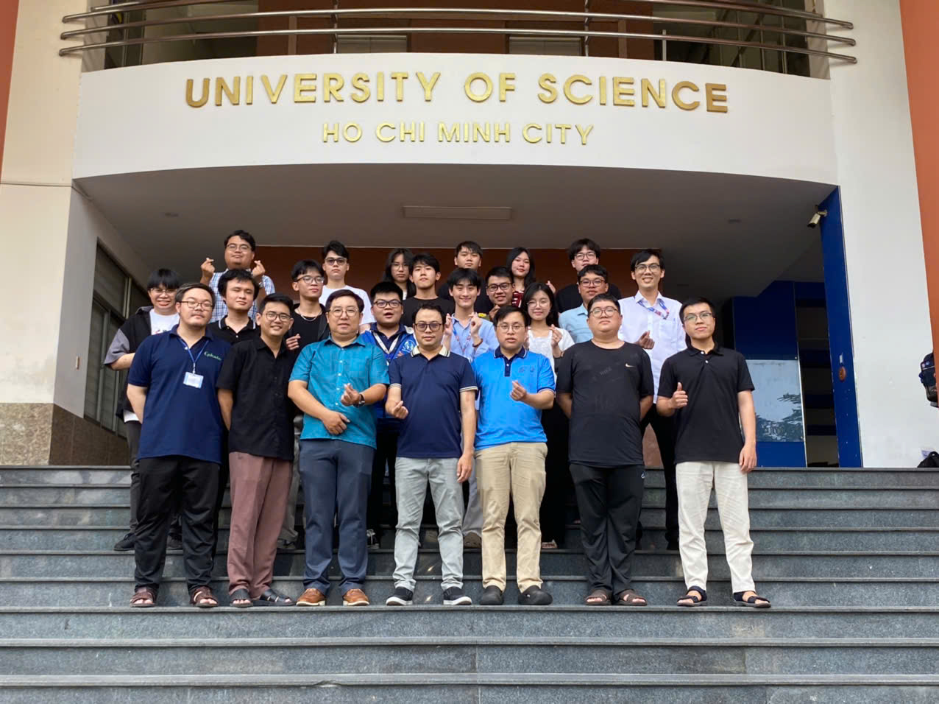
1. Our group: QuantumLab
Mission
  Develop new quantum computational methods for molecules and materials, on classical and quantum hardware
Team (2026)
  1 research associate
  3 PhD students
  4 MSc students
  11 undergraduate researchers
Infrastructure
  HPC cluster COMPHYS (CPU + GPU)
  Open-source code pyCMF, Qmes
QuantumLab members, 2026 · University of Science, Ho Chi Minh City

Slide 43
1. How a Project gets started
Phase 0 · Foundations: textbook, terms and definitions, hands-on software → report
Advisors: ready → a paper
Phase 1 · Reproduce: read the paper, re-run its experiments → report
Then the loop: read → report → experiment → read
  Each meeting: progress + discussion
Paper 1 stems from this loop

Slide 44
2. Change the encoding, change the result
New dataset → which encoding?
Why hard
  Expressive circuit → concentration (Lesson 2)
  May not match the problem's structure
  Number of circuits grows combinatorially
Today's practice
  Fixed circuit
  Brute force: 𝒪(|𝐾| 𝑁²) circuit runs, per dataset
Encoding | Acc
RBF (baseline) | 0.961
SRx | 0.957
HERx | 0.963
ZFM | 0.922

Slide 45
2. Two prior directions, two gaps
 | Incudini et al. (2024) | Neto (2025) | Paper 1
Idea | Search over many circuits, scoring each one | Data complexity measures → ML recommends a circuit | Data complexity measures → ML recommends an encoding
Target | Quantum kernel ✓ | Variational circuit | Quantum kernel ✓
Learns from the data | ✗ | ✓ | ✓
New dataset | New optimization loop | One prediction | One prediction
Gap | Costly loop per dataset; ignores the data | Not for quantum kernels | —
Their gaps are what Paper 1 builds on: quantum kernel + learn from the data

Slide 46

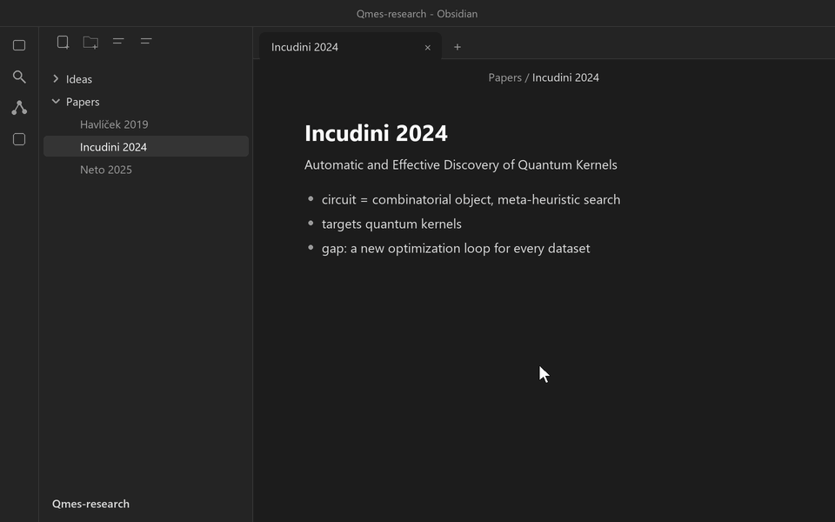
2. Papers in Zotero, ideas in Obsidian
Zotero: collect · organize · cite papers
Obsidian: notes · meeting minutes · reports, linked

Slide 47
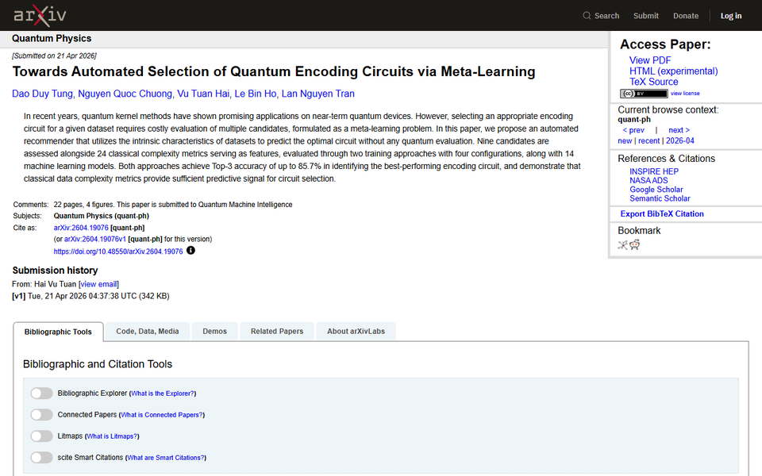
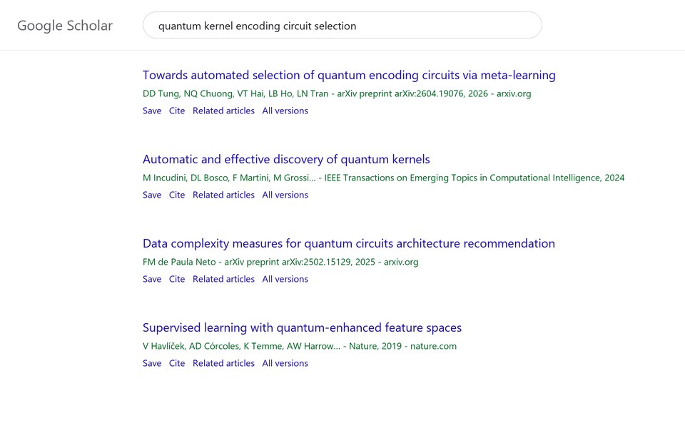
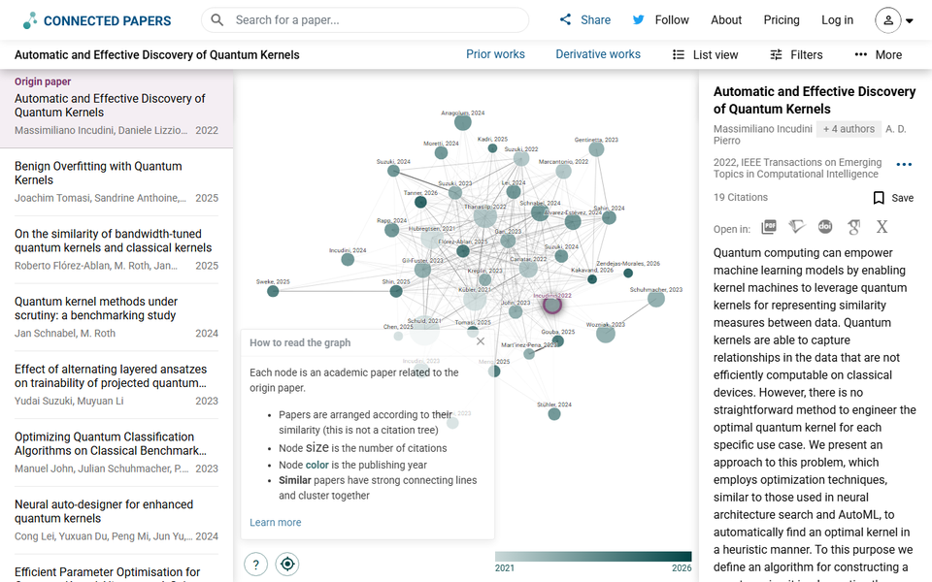
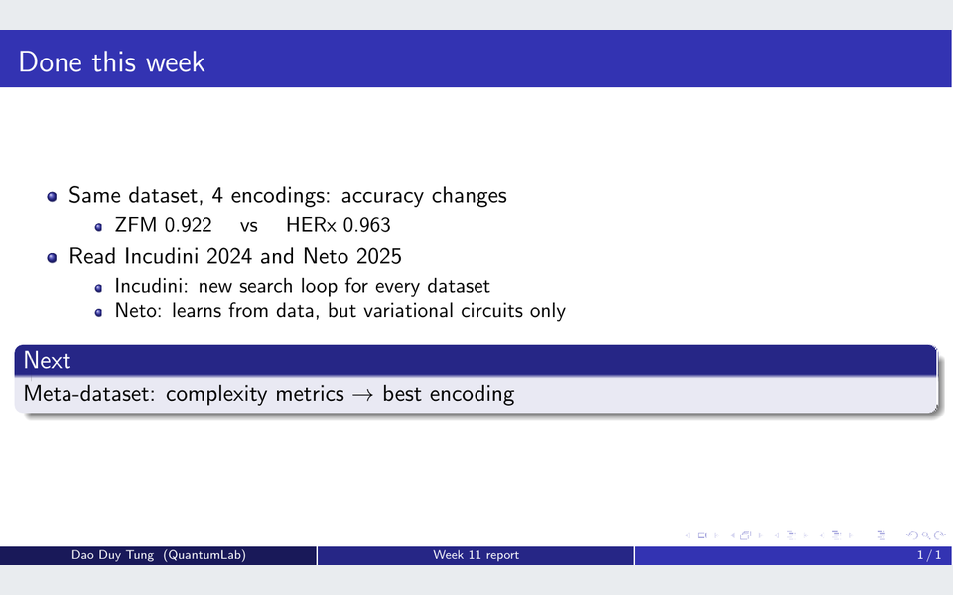
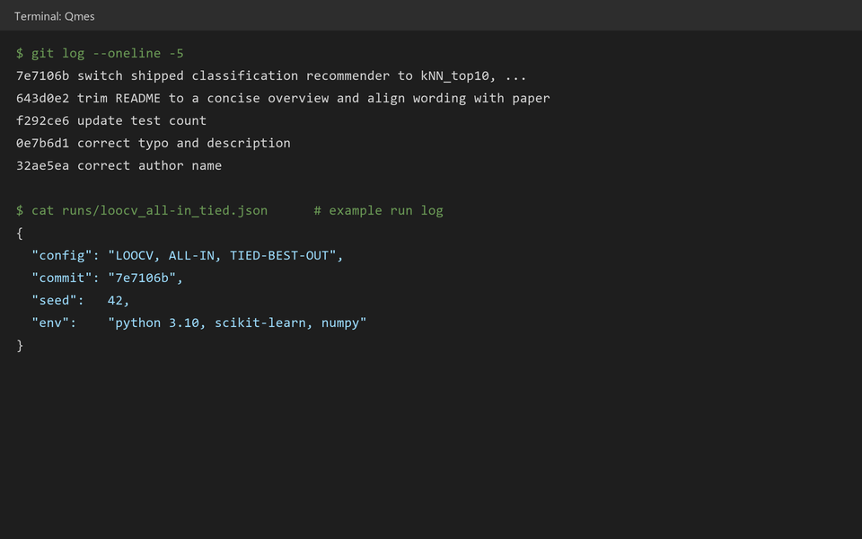
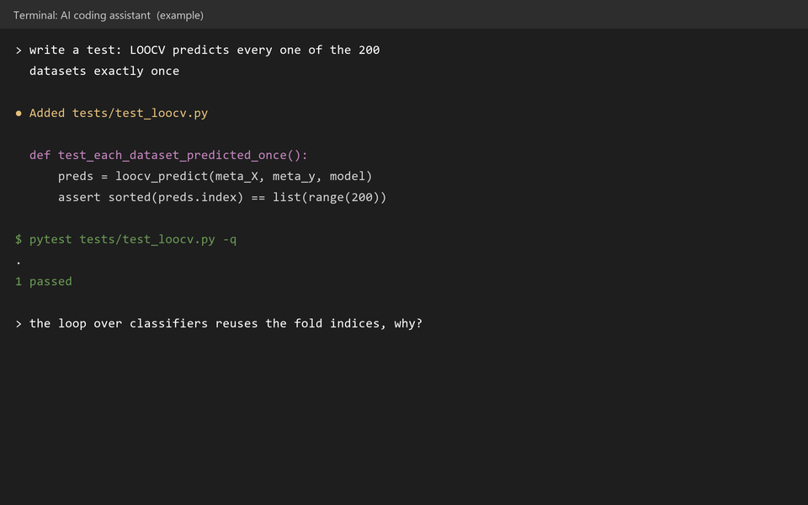
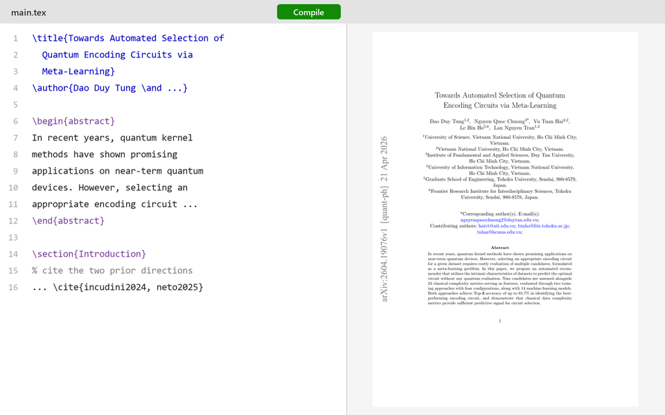
2. Other tools
arXiv · read
Google Scholar · read
Connected Papers · read
Beamer / Google Slides · report
Read → report → experiment → write
The loop of slide 4, then the paper
Real: arXiv, Connected Papers, Beamer
Mock-ups: Scholar, terminals, editor
Git + run log · experiment
AI coding assistant · experiment
LaTeX: Overleaf / local + git · write

Slide 48
3. A dataset vs a meta-dataset
Normal dataset
Meta-dataset: one row = one dataset
x₁ | x₂ | x₃ | x₄ | y
0.72 | 0.92 | 0.69 | 2.02 | malignant
0.45 | 1.83 | 0.67 | 1.32 | benign
1.73 | 1.02 | 1.12 | 2.18 | malignant
⋮
Dataset | F1 | L2 | … | Best circuit
Breast cancer | 0.17 | 0.01 | … | HERx
Moons | 0.27 | 0.13 | … | HD
Pima | 0.64 | 0.22 | … | SRx
⋮
455 rows · 4 features
200 rows · 24 metrics
(a) Build the meta-dataset: quantum only here, it generates the labels
(b) Train 𝑓
(c) New dataset → Top-𝑘 circuits: classical only

Slide 49
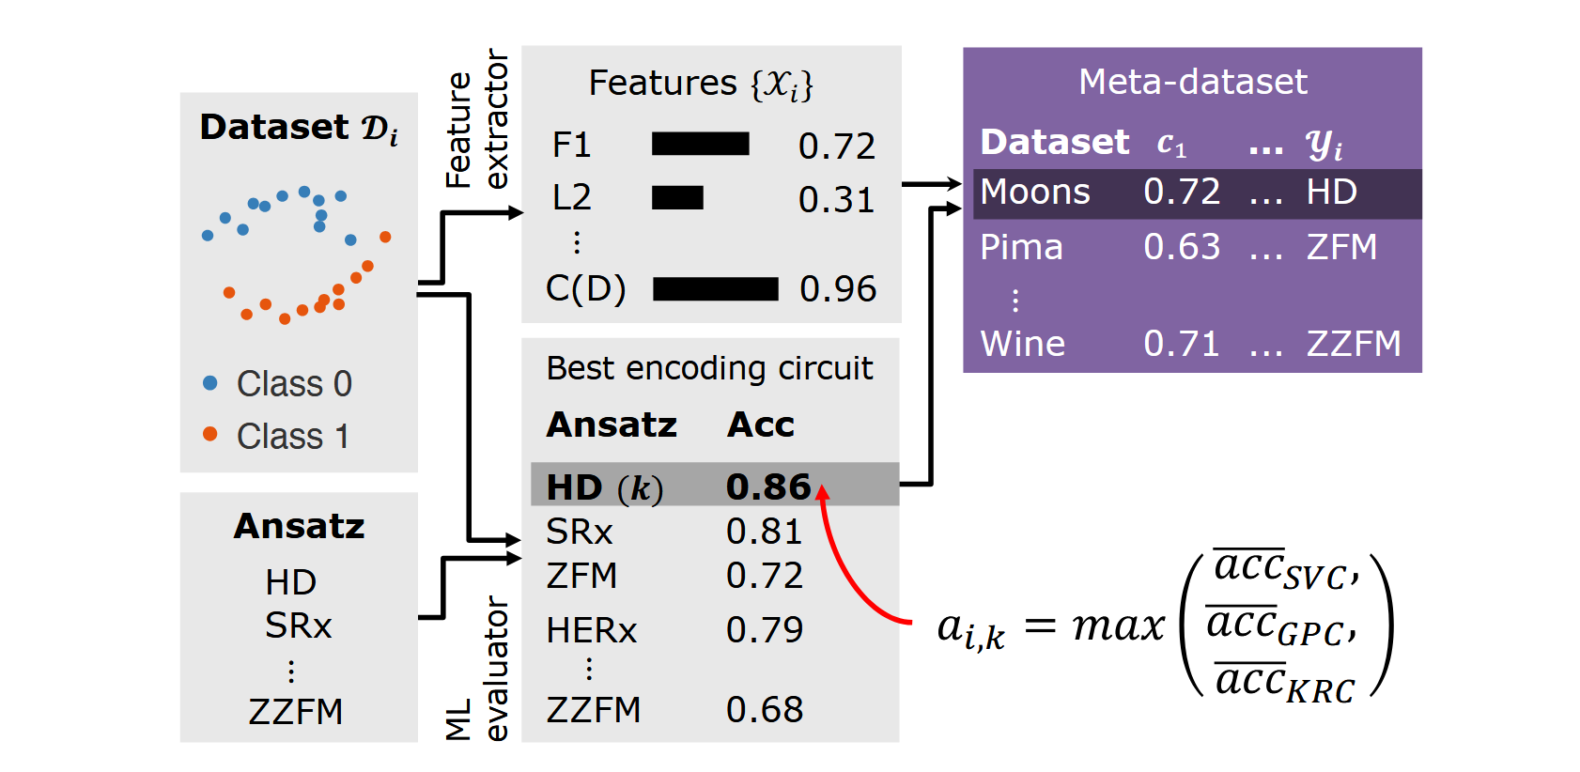
3. How to build a row in meta-dataset
① Features
Describe the dataset, classical
L2: error of a linear classifier
② Label
Run every circuit, keep the best
Only quantum step, the costliest
③ Repeat
200 datasets → 200 rows
Most datasets are generated
Source: Towards Automated Selection of Quantum Encoding Circuits via Meta-Learning, Fig. 2

Slide 50
3. How to choose the best circuit?
Score of circuit on dataset: 𝑎𝑐𝑐 = max(SVC, GPC, KRC)
  “Upper bound on what circuit 𝑘 can do”
What if the scores are equal, how can we choose the most optimal?
  Equal: HD 0.8625 · HERx 0.8625 · SRx 0.8625
  Does the single max really show what each circuit can do?
One winner: label = exactly one circuit, the best
  HD is 33% of all labels
Ties within 1%: label = every circuit within 1% of the best
  HD 20% · ZFM 20% · HERx 19% · SRx 17%

Slide 51
4. Building the recommender
Type | Classifiers (14)
Tree-based | Decision tree, random forest
Ensemble | Gradient boosting, AdaBoost, bagging
SVM | Linear, RBF, sigmoid kernel
Neural network | MLP, 1 or 3 hidden layers
Instance-based | k-NN, nearest centroid
Probabilistic | Naive Bayes, logistic regression
14 ordinary classifiers (see table)
MV (majority voting): keeps all 14
  Train all 14 on the meta-dataset
  Each one votes for a circuit
  Most votes = recommendation · vote order = Top-𝑘
LOOCV: keeps only the best one
  Hide one dataset, train on the rest, check the guess
  Repeat for every dataset
  The classifier that guesses best wins
A guess counts as right if it is one of the circuits tied for best

Slide 52
4. On the meta-dataset: ties make it learnable
 | One winner | Ties within 1%
24 metrics | ≈ 0.69 | ≈ 0.85
1 metric (the best one) | ≈ 0.55 – 0.59 | —
24 metrics beat 1: no single metric is enough
With ties, the classifier only needs the right family of circuits

Slide 53
5. Inference on new dataset
Digits 0v1 · Moons · Circles · Synthetic · GaussianQuantiles · MultiRing · Imbalanced
 | Top-1 | Top-3
MV · 24 metrics | 3/7 | 6/7
LOOCV · 24 metrics (RF) | 5/7 | 6/7
MV · 1 metric (N4) | 2/7 | 5/7
LOOCV · 1 metric (E-GB, N4) | 2/7 | 5/7
Top-3: run ≤ 3 of 9 circuits, not all 9
One metric is not enough

Slide 54
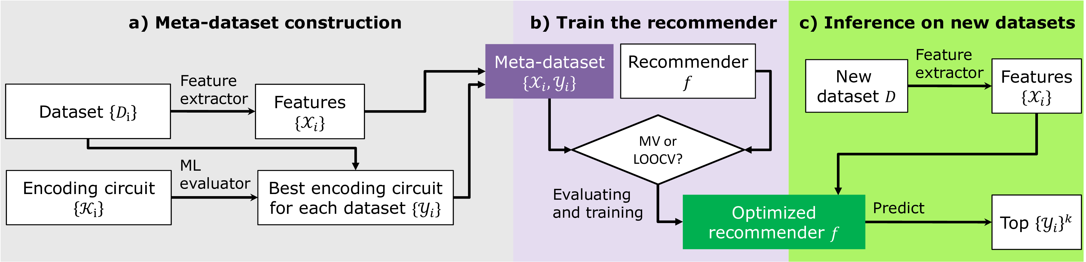
5. Paper 1 in a nutshell
Towards Automated Selection of Quantum Encoding Circuits via Meta-Learning
(a) A point = a dataset, its metrics, its best circuit; quantum runs only here, once, offline
(b) MV or LOOCV: 14 classifiers → one recommender
(c) New dataset → Top-𝑘 circuits; no circuit runs

Slide 55
6. Paper 1 answers one question
Answered
  Classical complexity metrics carry enough signal to choose an encoding
  New dataset: no circuit runs to get a recommendation
Limits
  Proof-of-concept: 200 datasets, mostly synthetic
  Tested on 7 new datasets
  Classification only
  Research code: no package, no pre-trained model
Also open: quantum descriptors (expressibility, entanglement) · noise models · recommender → designer
Lesson 5: from a paper to a package others can use

Slide 56
From paper to package
Lesson 5 · Quantum machine learning

Slide 57
Outline
Purpose
Bottlenecks
Architecture
Wrap-up

Slide 58
1. From “is the idea right?” to “can others use it?”
 | Paper 1 · research paper | Paper 2 · software paper (Qmes)
Question | Is the idea right? | Can others use it?
What a reader gets | Paper · code on GitHub | Installable package · pre-trained model
To use it on your data | Rerun the pipeline, train 𝑓 yourself | pip install → recommend(X, y)
Without a recommender: 𝒪(|𝐾| 𝑁²) circuit runs per new dataset (|𝐾| circuits · 𝑁 samples)
With Qmes: a recommendation without running any circuit
We already tried every circuit on ≈ 100 datasets per task, once, offline
We try every circuit once, offline, so users don't have to.

Slide 59
1. Three goals
Usable | Applicable | Extensible
Install and run Recommend without running any circuit | The user's own data Classification + regression Checked on 105 + 86 datasets | Add your own circuit or task Pluggable components
Usable
from Qmes import get_extractor, load_default_recommender, recommend
ext = get_extractor("classification")
rec = load_default_recommender("classification")
recommend(X, y, extractor=ext, recommender=rec)
No circuit runs, classical only
To use the chosen circuit, you still run it

Slide 60
2. Q1 · From synthetic to real data
Real vs synthetic datasets
New problems
Real data are often imbalanced
  Accuracy can look good while the model learns nothing
  Score each circuit with MCC
Some datasets teach nothing
  Every circuit ≈ random, or every circuit ≈ perfect
  Drop them before training

Slide 61
2. Q2 · Only ≈100 datasets
1 dataset = 1 sample
label = best of 7 circuits
≈100 samples, 7 labels
→ too few examples per label
Easier question:
“is A better than B?” (yes/no)
Training (once): a ✓/✗ on every dataset
 | D1 | D2 | D3 | … | D100
HD > RY ? | ✓ | ✗ | ✓ | … | ✓
New dataset: each answer is a vote
HD > RY ? | ✓ | HD +1
HD > SRx ? | ✓ | HD +1
RY > SRx ? | ✗ | SRx +1
Votes: HD 2 · SRx 1 · RY 0 → Ranking: HD, SRx, RY
7 circuits → 21 questions, same voting (OvO)

Slide 62
2. Q3 · How many features do we need?
Problem: Paper 1 uses all metrics. Are all of them needed?
Our solution: keep only the most informative metrics
  rank metrics → keep top k → test each k

Slide 63
2. Q4 · Performance evaluation metric
Regret = score of the best circuit − score of the recommended circuit
Paper 1: only hit / miss
  A miss can lose 0.001 or 0.08 → hit/miss can’t tell them apart
Need: how much is lost? → regret
With regret: better than a naive choice?
  Naive = always the best-on-average circuit
  Qmes loses 2–4× less
Qmes: Quantum Meta-Learning for Encoding Selection in Quantum Kernel Methods

Slide 64
2. Q5 · From code to a ready-to-use model
Code only (Paper 1)
  To get a recommendation on your data: rebuild the meta-dataset = run every circuit on every dataset
  Then train the recommender yourself
Qmes package: pip install from GitHub
  ✓ The code
  ✓ The simulator (Qsun): nothing else to install
  ✓ Trained recommenders, one per task
→ Users get the result of the expensive part without redoing it

Slide 65
3. Qmes pipeline
Offline · run once
  Dataset → Extractor: describe the dataset (metrics)
  Dataset → Evaluator: run every circuit, score it; the only quantum block (Q1)
  Meta-dataset → train the Recommender (Q2 · Q3 · Q4)
  Trained Recommender → in the package (Q5)
Per new dataset · no circuit runs
  New dataset → Extractor → Recommender → top-3 circuits
Each block can be swapped: regression was added this way

